Slide 1
C SYNTAX CHECKER

Slide 2
INTRODUCTION
The C Syntax checker to create a program that checks the syntax of a given C code file. This project will involve reading a C code file, analyzing its syntax, and providing feedback on any syntax errors found.
This project is useful for learning more about C programming langage syntax and parsing techniques. The Program will help people identify common C syntax mistake.
This project aims to develop a C Syntax Checker, a tool designed to analyze and verify the syntactic correctness of C programming language code.
The checker employs lexical analysis and parsing techniques to identify and report syntax errors, ensuring adherence to the rule and structure specified by the C language grammar.

Slide 3
WHY C USED?
C++ is convinent for creating a C syantax checker because C++ is a superset of C , meaning it includes all of C’s features and syntax, plus more. This makes it easier to write a syntax checker for C in C++, as you can leverage C++ additional features and libraries while still understanding and parsing C syntax.

Slide 4
OBJECTIVES
This Program will help people identify common C syntax mistake mentioned below that they had done in their program and some checks.
* Bracket Checks
* Bulitin Function Call
* Prototype
* Check Keyword with line number
* Remove Comments and empty spaces from program
* Keyword syntax errors
* Total lines in code

Slide 5
METHODOLOGY
Lexical Analysis : The input C code is tokenized to break it down into individual tokens such as keywords, identifiers, operators, and symbols.
Parsing : The tokenized code is parsed according to the rules of the C language grammar using techniques like recursive descent parsing or LR parsing.
Syntax Verification : During parsing, the syntax checker verifies that the sequence and structure of tokens conform to the rules of the C language grammar.It checks for correct placement of syntax elements such s braces, parentheses, semicolons, etc.
Error Detection : Any syntax errors are encountered during parsing, the syntax checker identifies and reports them. Errors may include missing semicolons, mismatched parentheses, undeclared variables, incorrect usage of operators,etc.

Slide 6
Error Reporting : Informative error messages are generated to help the programmer understand and correct the identified syntax errors.
Symbol Table Construction : The Syntax checker may also construct a symbol table to keep track of declared variables, functions, and other identifiers, enabling it to perform additional checks such as variable scope and type compatibility.
Testing and Validiation : The syntax checker is rigorously tested using a variety of C code examples, to ensure its accuracy and reliability.

Slide 7
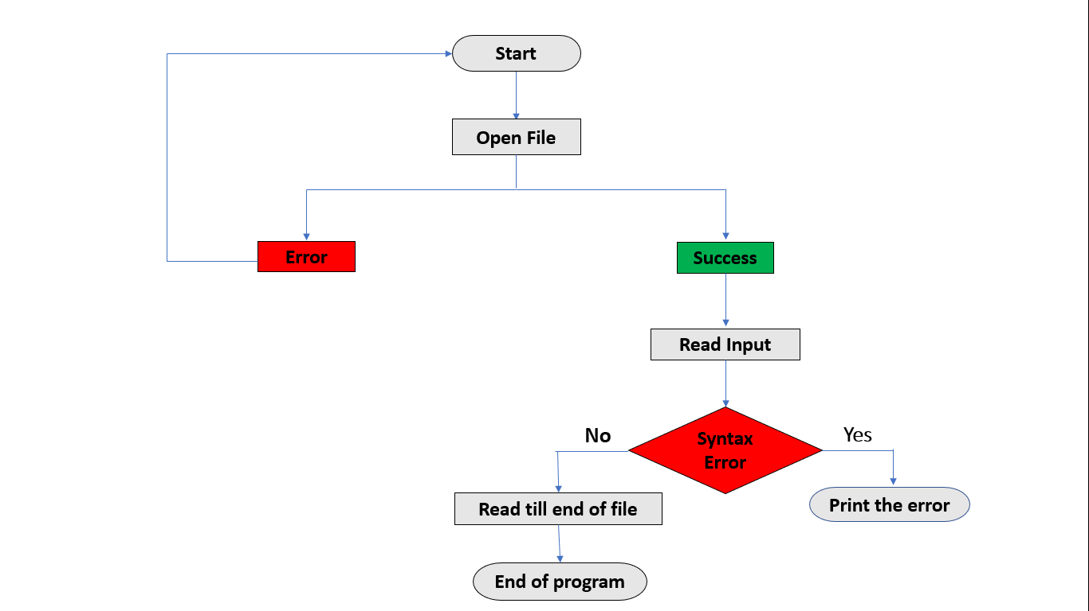
FLOWCHART :

Slide 8
IMPLEMENTATIONS STEPS
Define the Grammar :
Understand and define the grammar rules of the C programming language. This includes syntax rules for statements,expessions, declarations,control structures,etc.You can refer to the C language standard for this purpose.
Lexical Analysis(Lexer) :
Implement a lexical analyzer to tokenize the input C code. The lexer breaks the input text into a sequence of tokens. Define regular expressions or finite automata to recognize tokens such as keywords, identifiers, literals, operators, and punctuation.
Syntax Analysis(Parser) :
Implement parsing algorithms such as recursive descent, LL(1), LR(1), or LALR(1) to construct a parse tree or an abstract syntax tree(AST). Handle grammar rules, precedence, associativited error recovery.

Slide 9
Error Reporting :
Develop mechanisms to report syntax and semantic errors detected during analysis.
Code Quality Checks :
Optionally, implement checks for coding standards, style guidelines, and best practices.
Testing and Validation :
Develop comprehensive test cases to verify the correctness and robustness of the syntax checker.
Documentation and User Interface :
Provide documentation for users, including instructions on how to use the syntax checker and interpret error messages.

Slide 10
APPLICATIONS :
Code Quality Assurance
Error Detection
IDE Integration
Automated Testing
Education
Code Reviews

Slide 11
FUTURE SCOPE :
The Scope of a C syntax checker can vary depending on the complexity and features you want to implement.
1) Enhanced Language Support
2) Integration with AI and Machine Learning
3) Context-aware Suggestions
4) Real-time Collaboration Tools
5) Static Analysis and Security Checks
6) Incremental Analysis

Slide 12
REFERENCE :
https://www.interviewbit.com/blog/cpp-projects/
https://www.knowledgehut.com/blog/programming/c-plus-plus-projects
https://github.com/topics/c-syntax-checker

Slide 13
THANK YOU

